Slide 1


Predicting customer buying behaviour
PRESENTED BY
S M GAZZALI ARAFAT NISHAN
Date: 26-07-2023

Slide 2
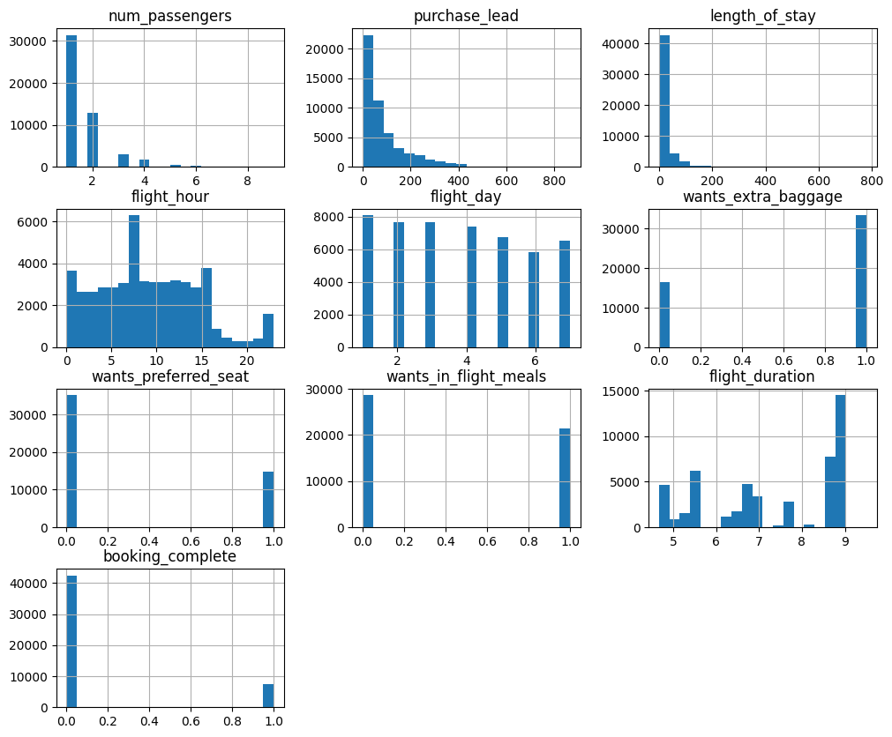
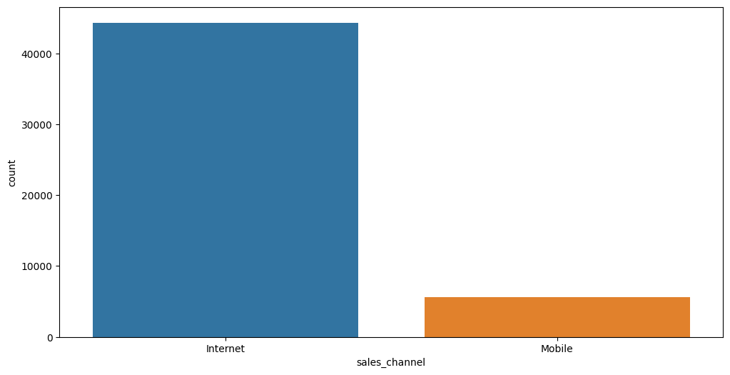
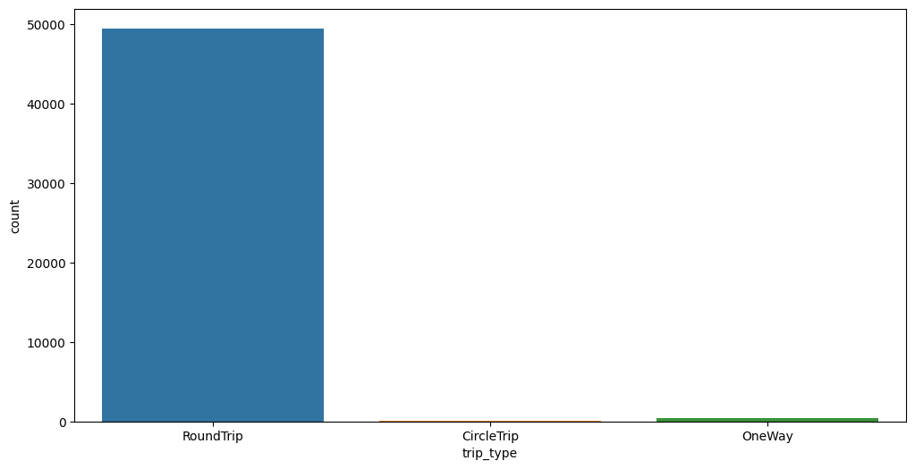
Exploring the Dataset with Visualizations and Other Metrics

Slide 3
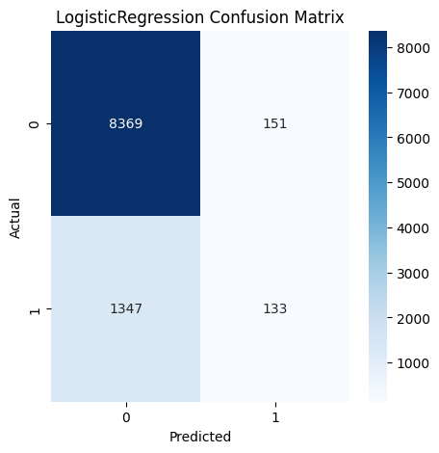
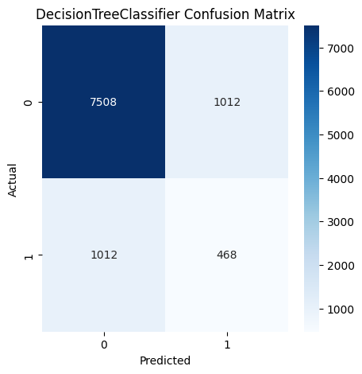
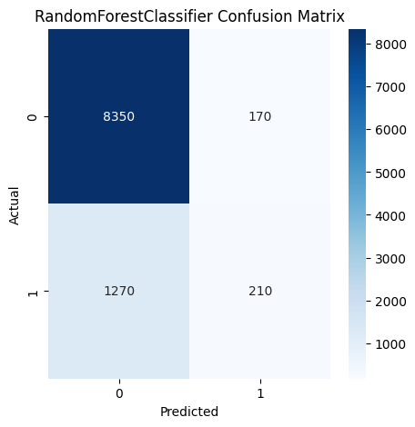

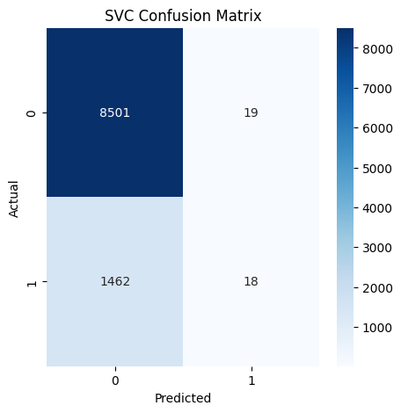
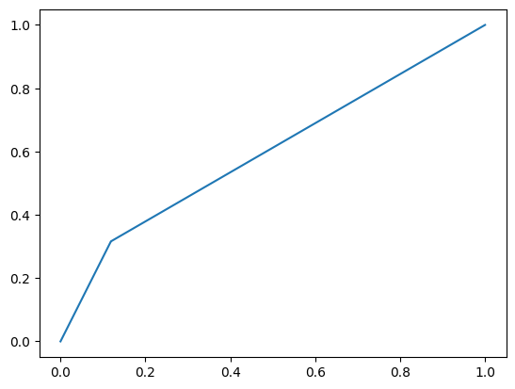
Evaluate the Model with Accuracy, Confusion Matrix, ROC and AUC, and F1 Score
Random Forest Classifier Accuracy : 0.86
Logistic Regression Accuracy : 0.85
Gradient Boosting Classifier Accuracy : 0.85
SVC Accuracy : 0.85
Decision Tree Classifier Accuracy : 0.80
Random Forest Classifier Accuracy : 0.86

Slide 4
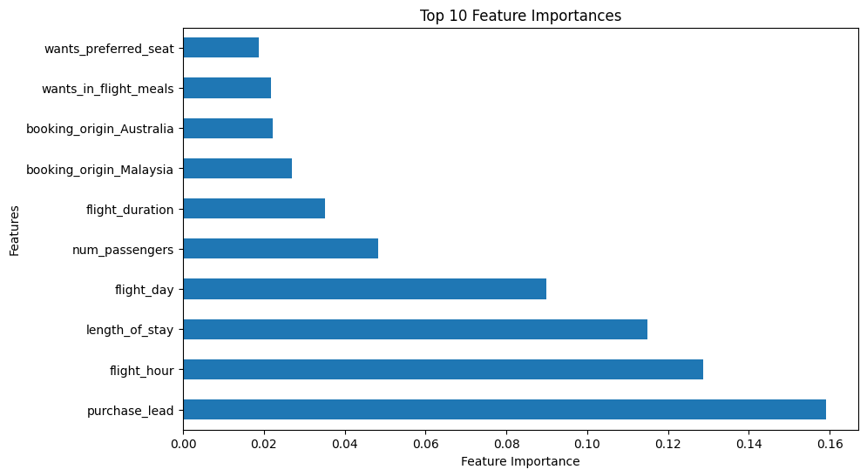
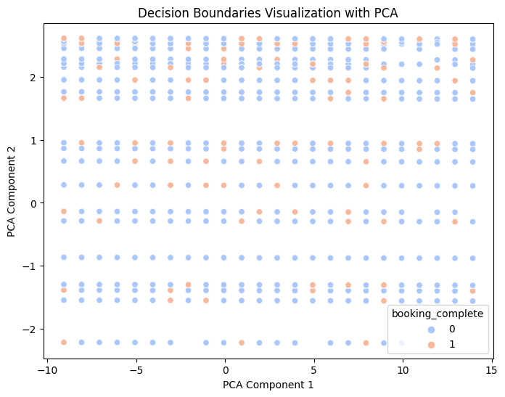
Showing Output Visualizations for the Contributing Variables

Slide 5
THANK YOU
S M Gazzali Arafat Nishan
gazzali.nishan@northsouth.edu
www.beacons.ai/hashcatnissan

